Slide 1
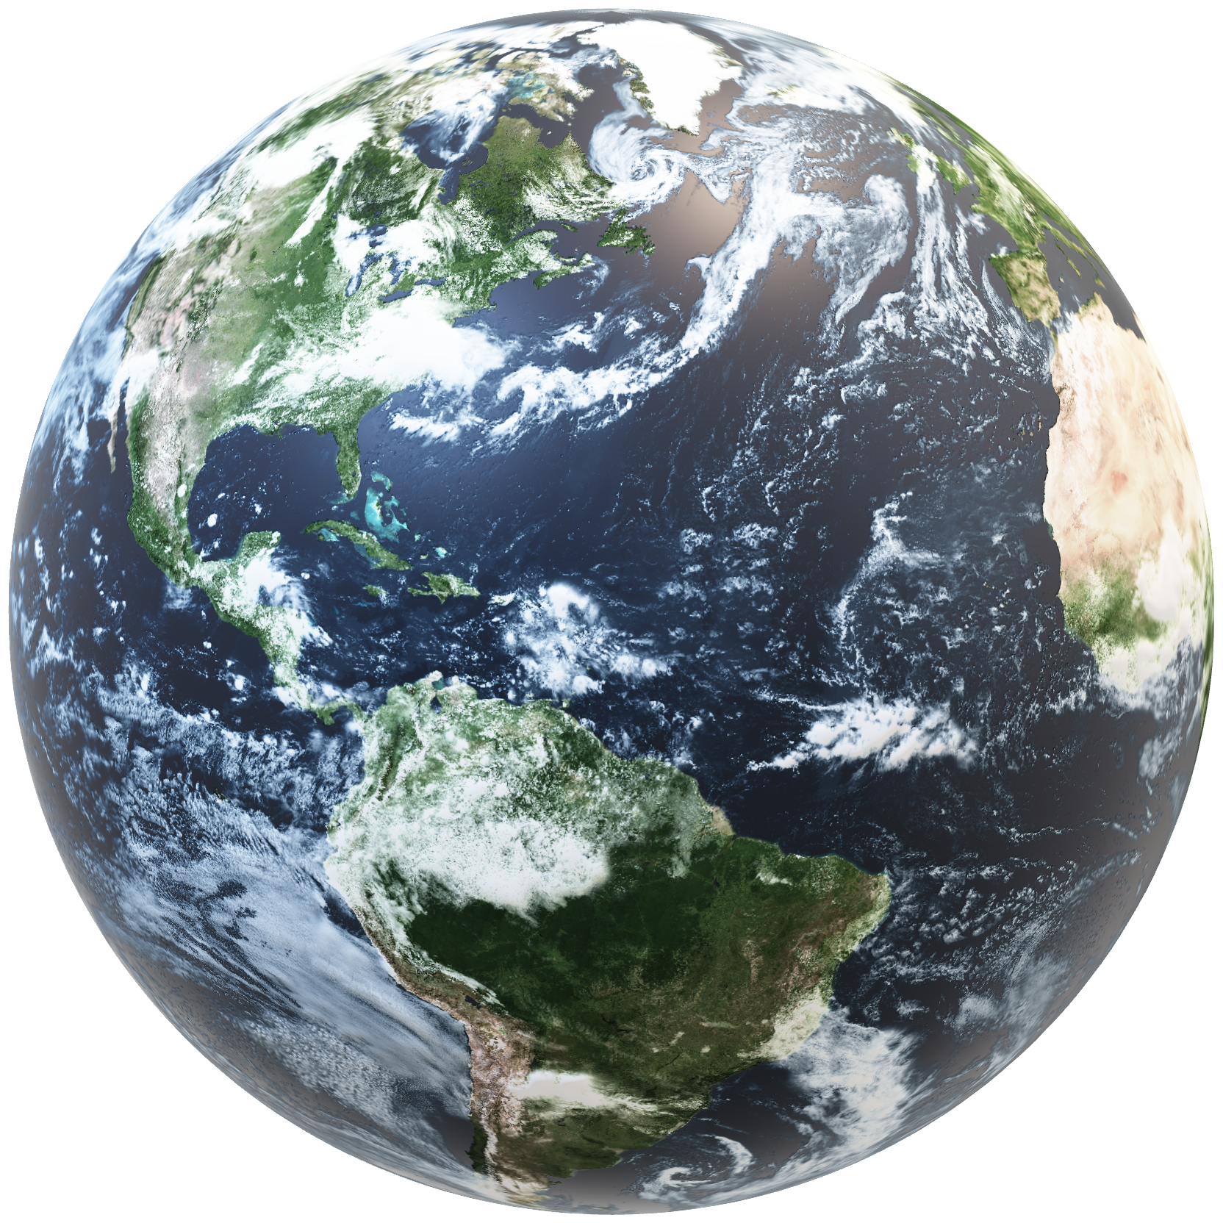
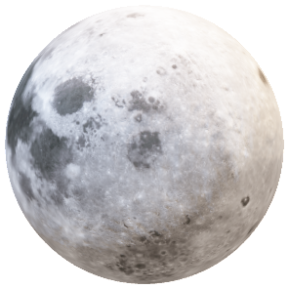
Smart Alarm
Engineering Rizzards

Slide 2

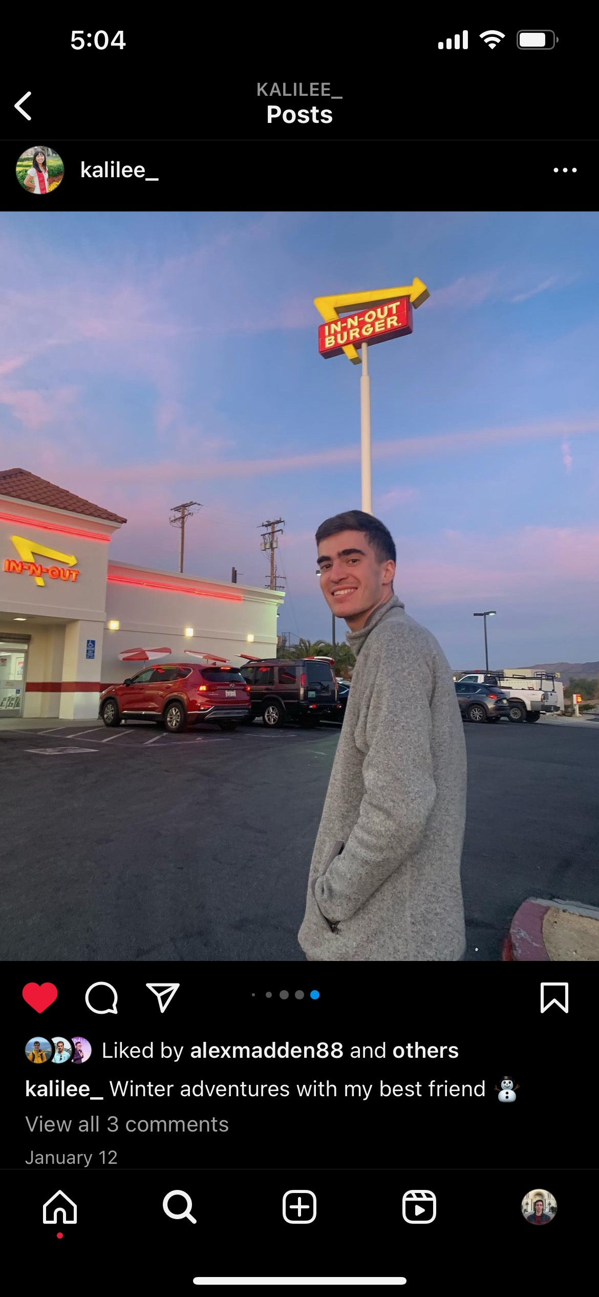


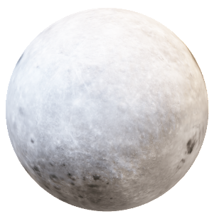
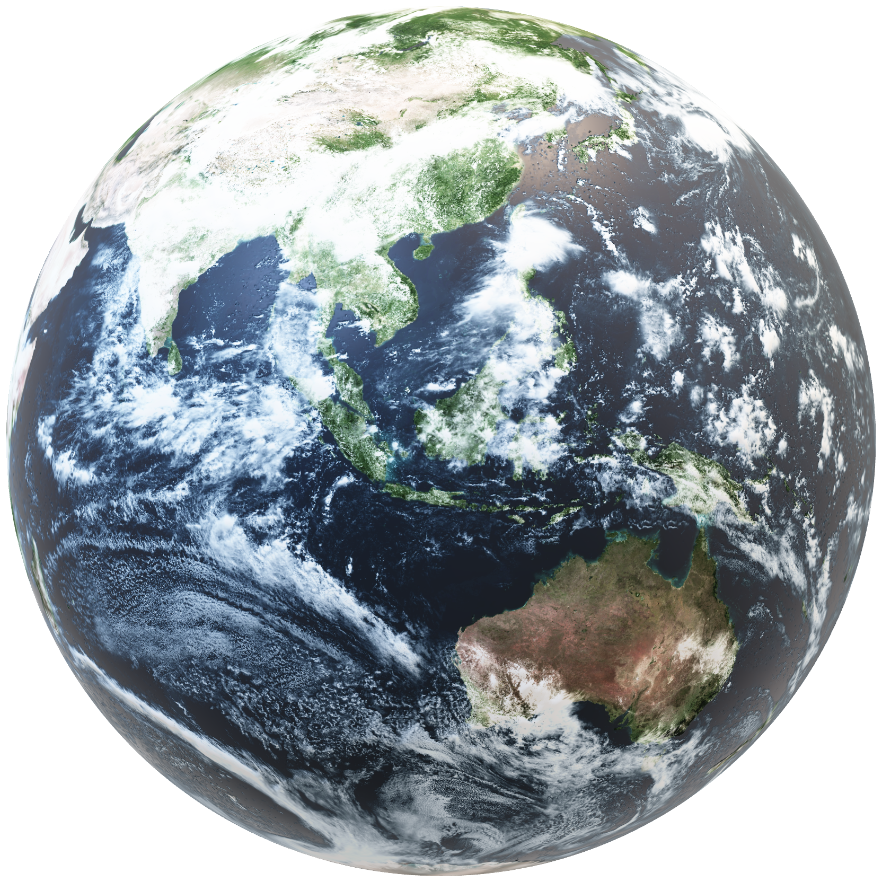
The Team
Anuja Shah
Alex Madden
Reeth Kawad
Elliot Starkman

Slide 3
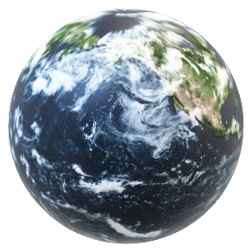
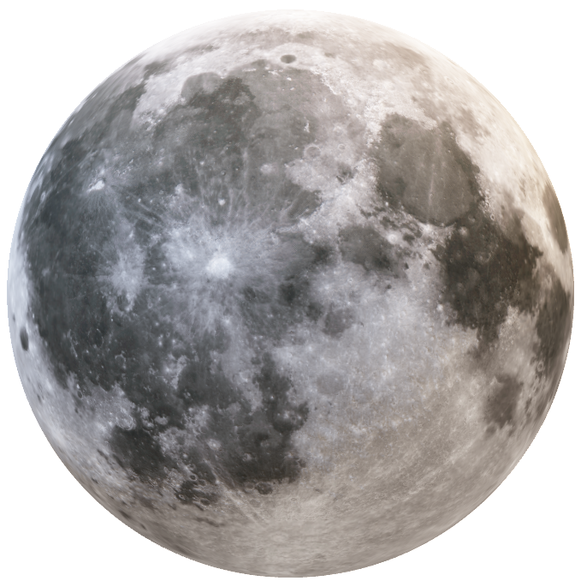
Background: The Sleep Stages
WK: Wake/Alert
N1:
Light Sleep
N2:
Deeper Sleep
Resting Heart Rate
Alert Brain Activity
5% of cycle
1-5 minutes
Normal heart rate
45% of cycle
25+ minutes
Sleep spindles
Heart rate drops
N3:
Deep Sleep
REM:
Rapid-Eye-Movement
25% of cycle
1-60 minutes
Body heals
Sleep walking, night terrors
25% of cycle
1-60 minutes
Dreaming Stage
Increased pulse/brain activity
Source: https://www.ncbi.nlm.nih.gov/books/NBK526132/#:~:text=Sleep%20occurs%20in%20five%20stages,stage%20a%20progressively%20deeper%20sleep.

Slide 4
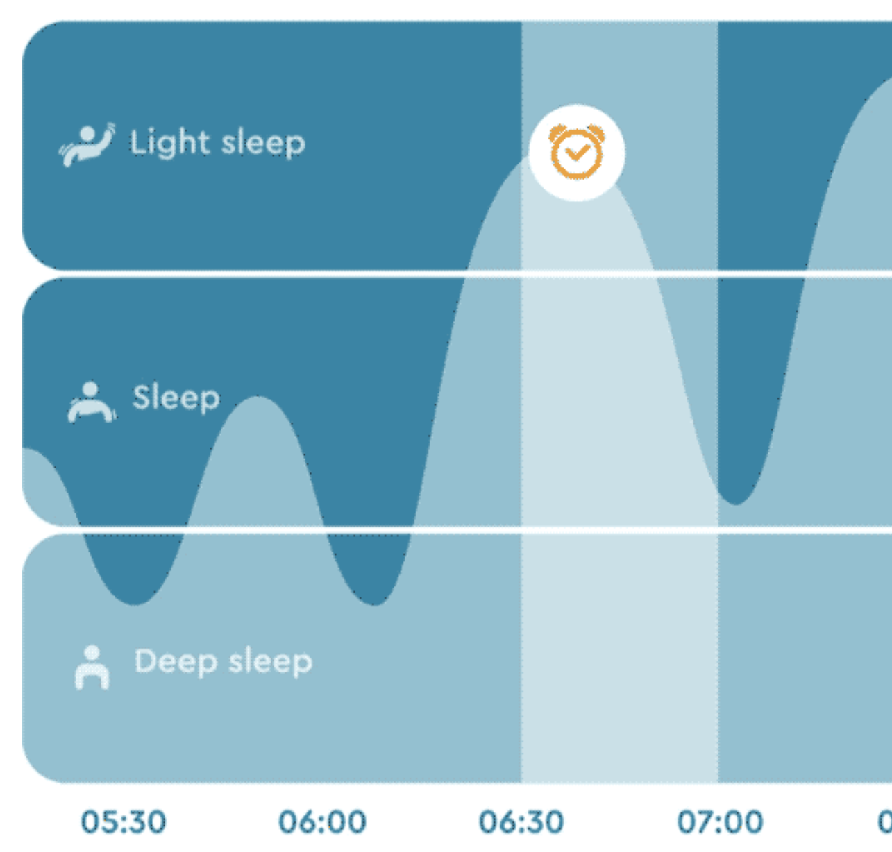
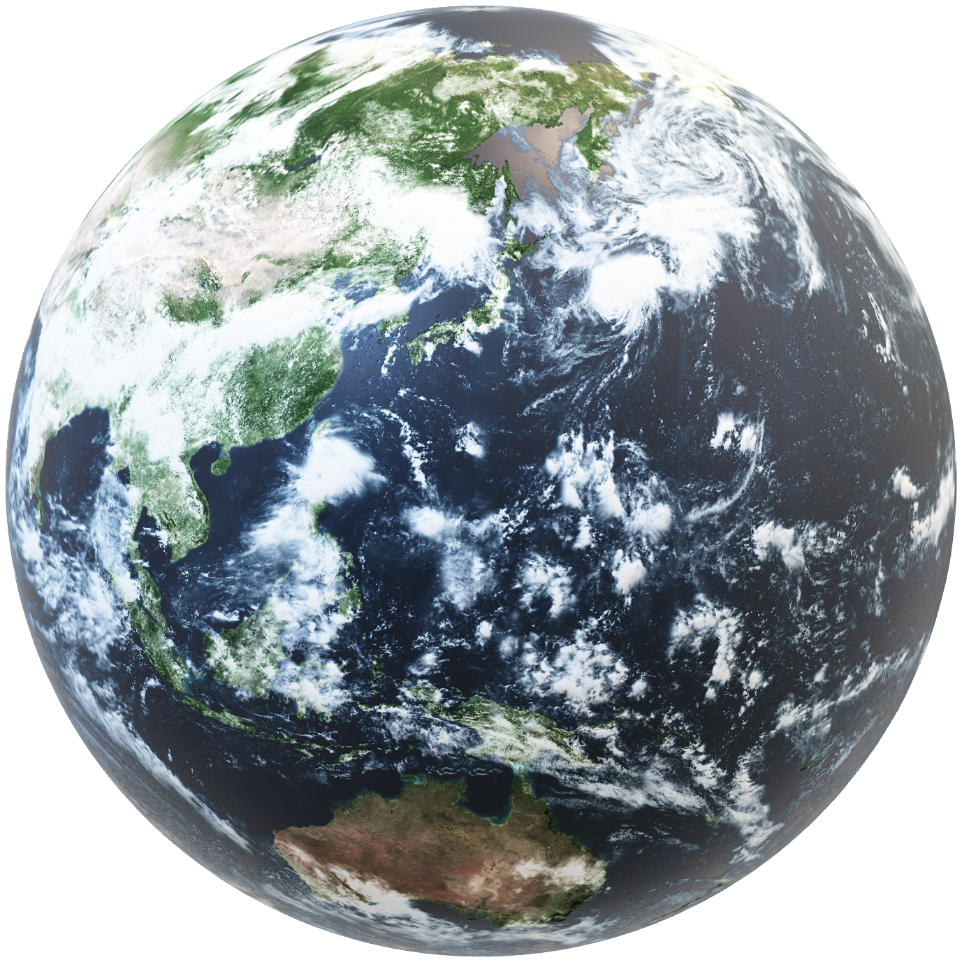
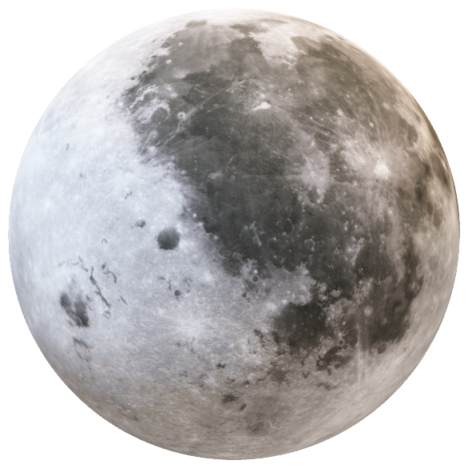
Optimal Sleep Stage For Waking: N1
N1:
Light Sleep
With healthy sleep schedule, wake up during this or during REM sleep in morning
Least likely to experience sleep inertia, wake up with grogginess
Most likely to feel well-rested

Slide 5
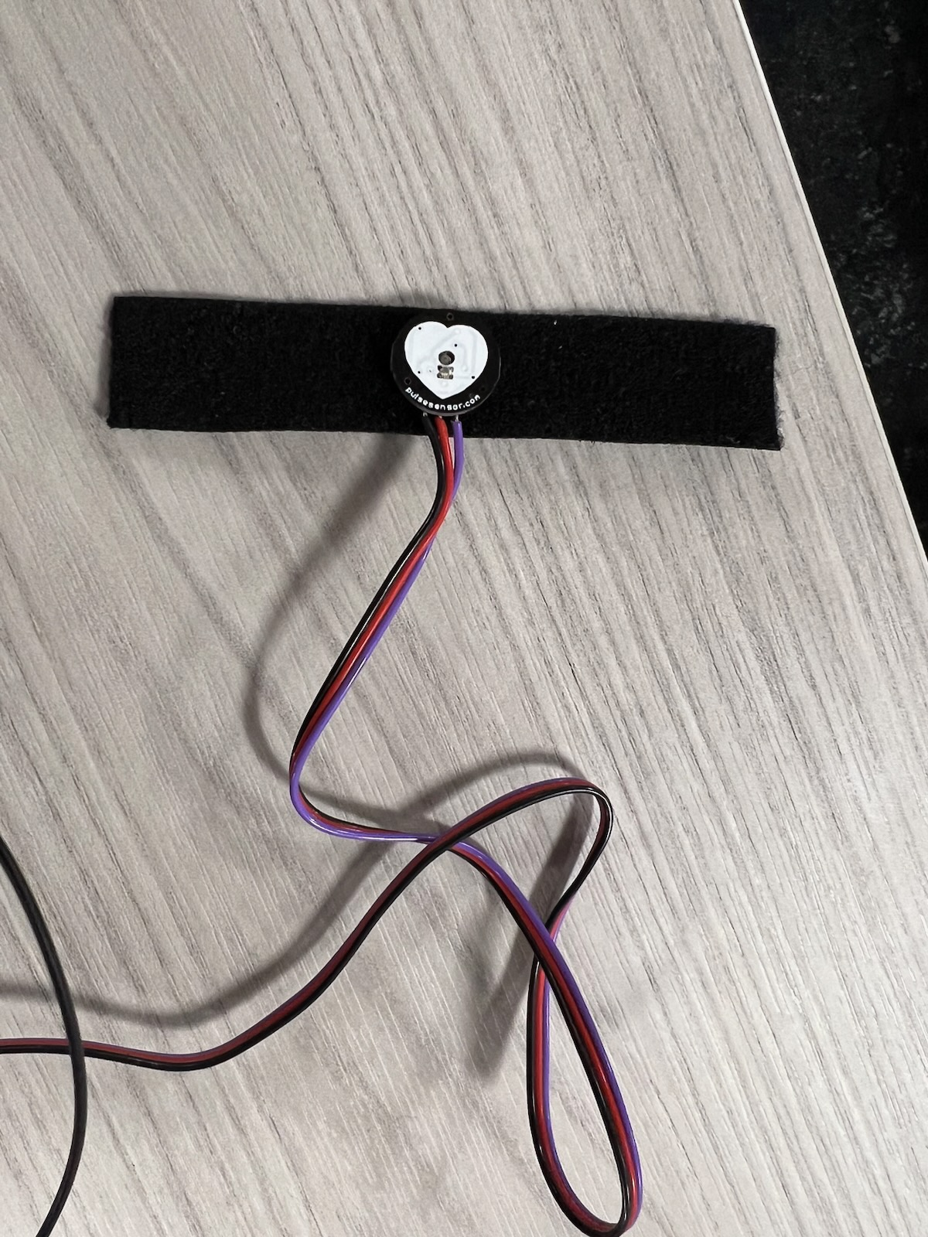
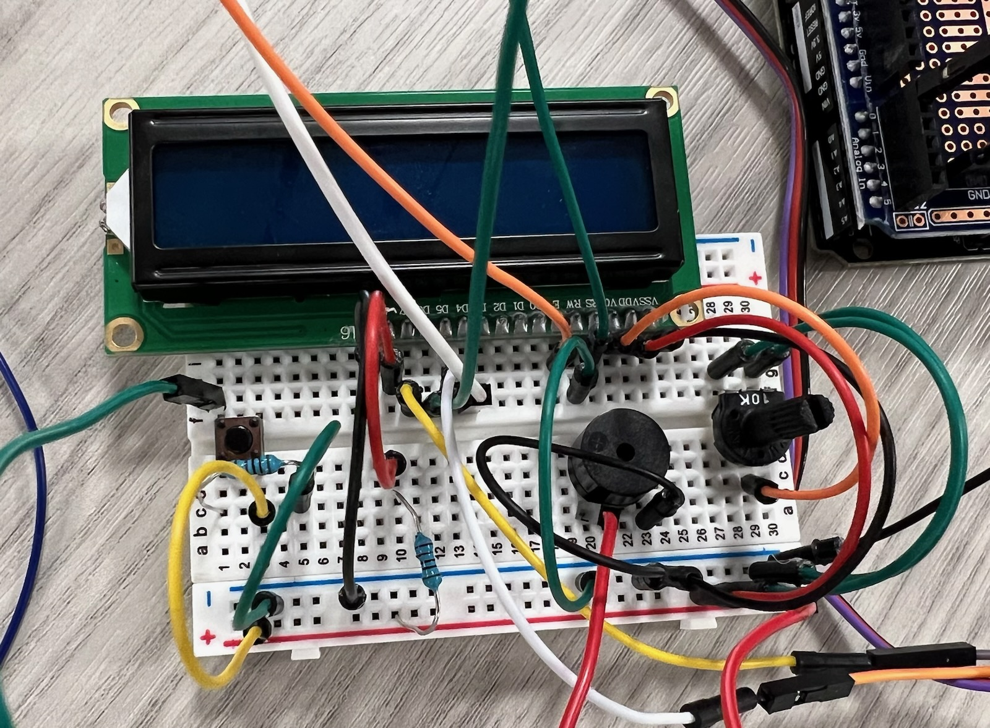
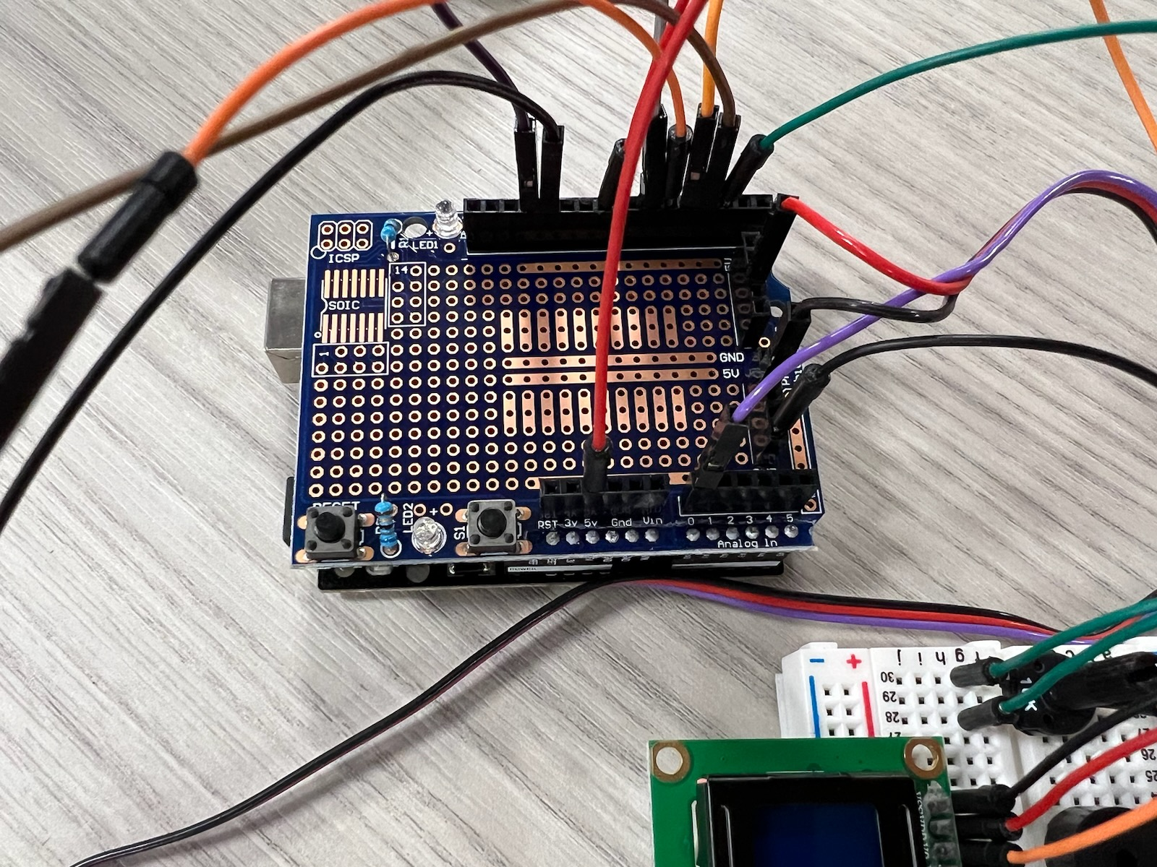
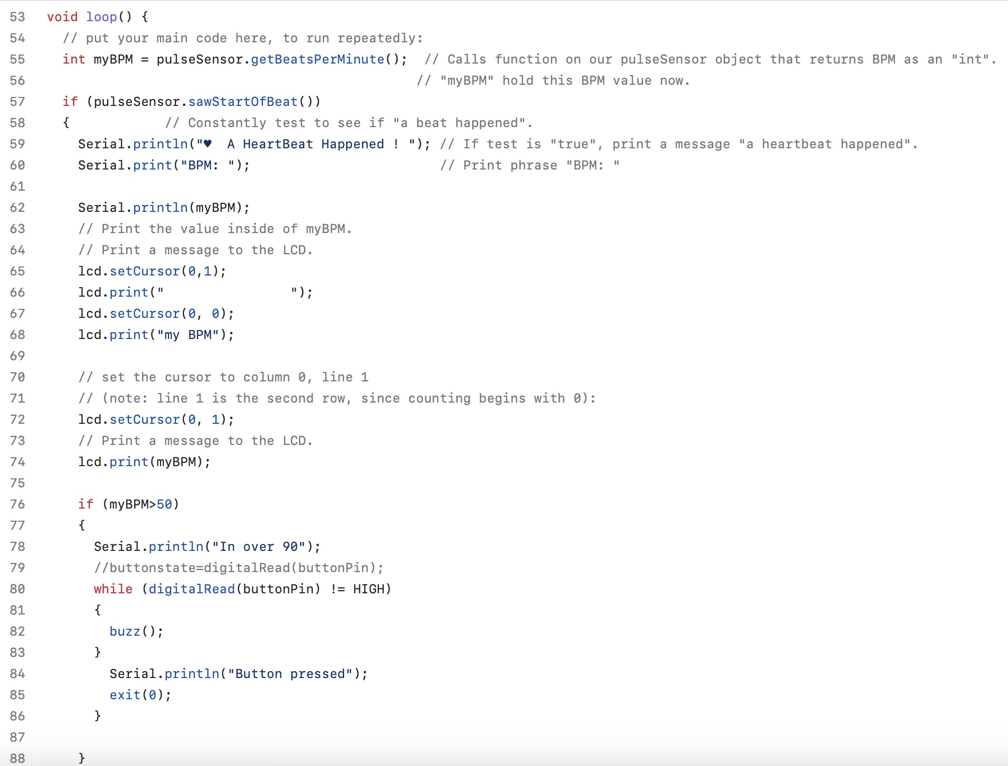
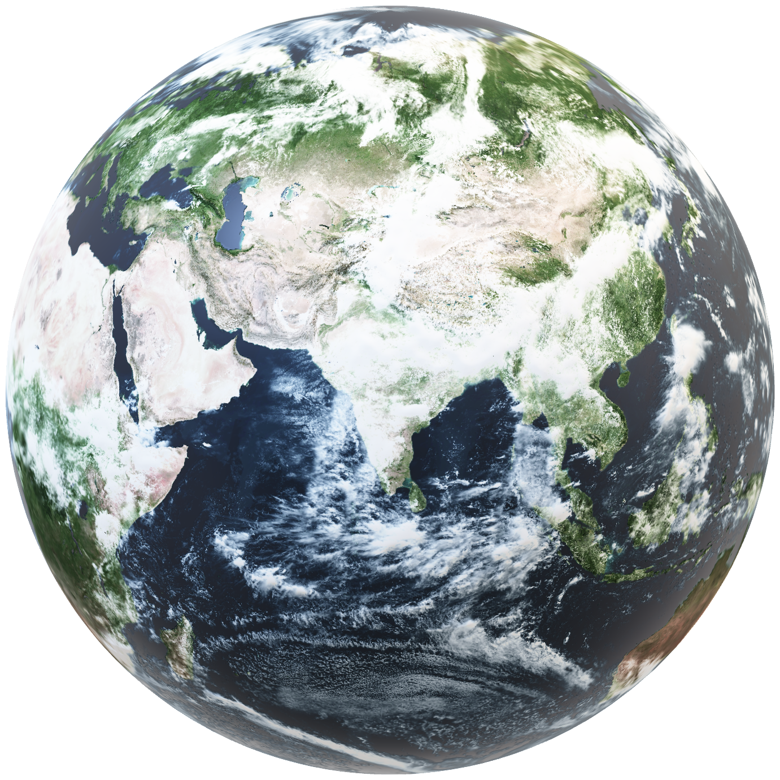
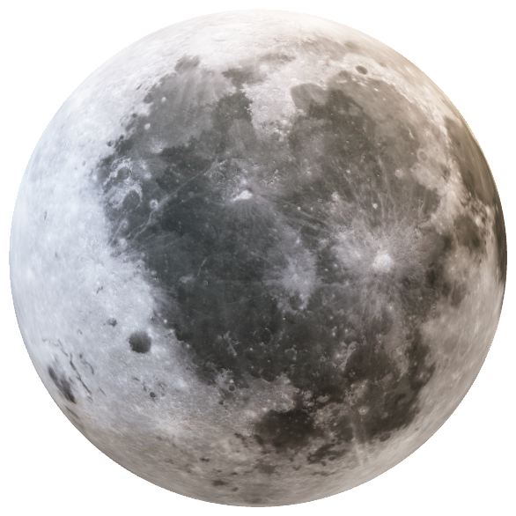
The Prototype: Components
Heartbeat Sensor
Breadboard
UNO R3
Code
LCD
Displays time, heart rate
Speaker
Plays alarm sound
Button
Stops Alarm
Displays BPM on LCD
Interprets/compares heart rate to a preset threshold
Sends frequencies to buzzer when threshold is met, kills buzzer at button press
Pulls heart rate from user
Relays information to UNO R3
Interprets signal from Heartbeat Sensor
Interfaces with computer/code

Slide 6
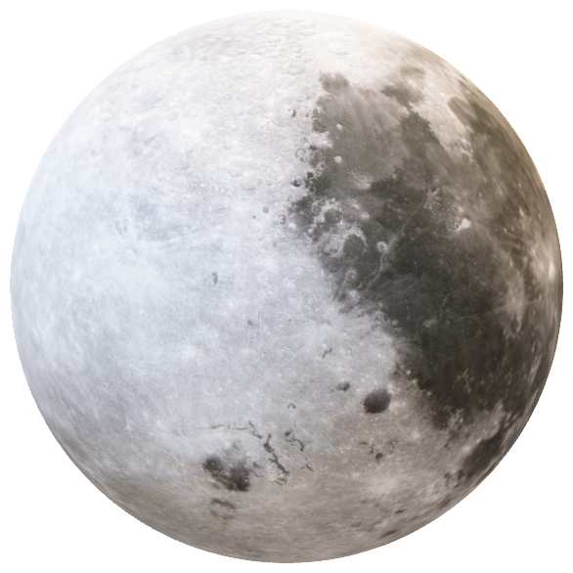
The Prototype:
Demonstration

Slide 7
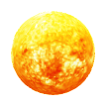
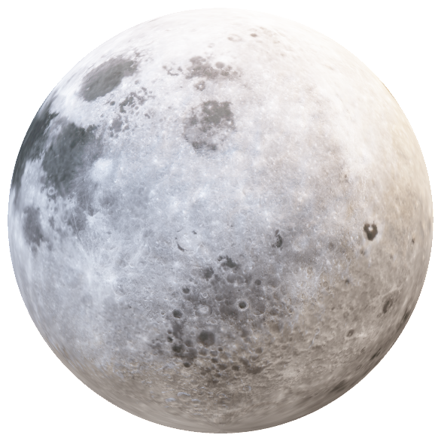
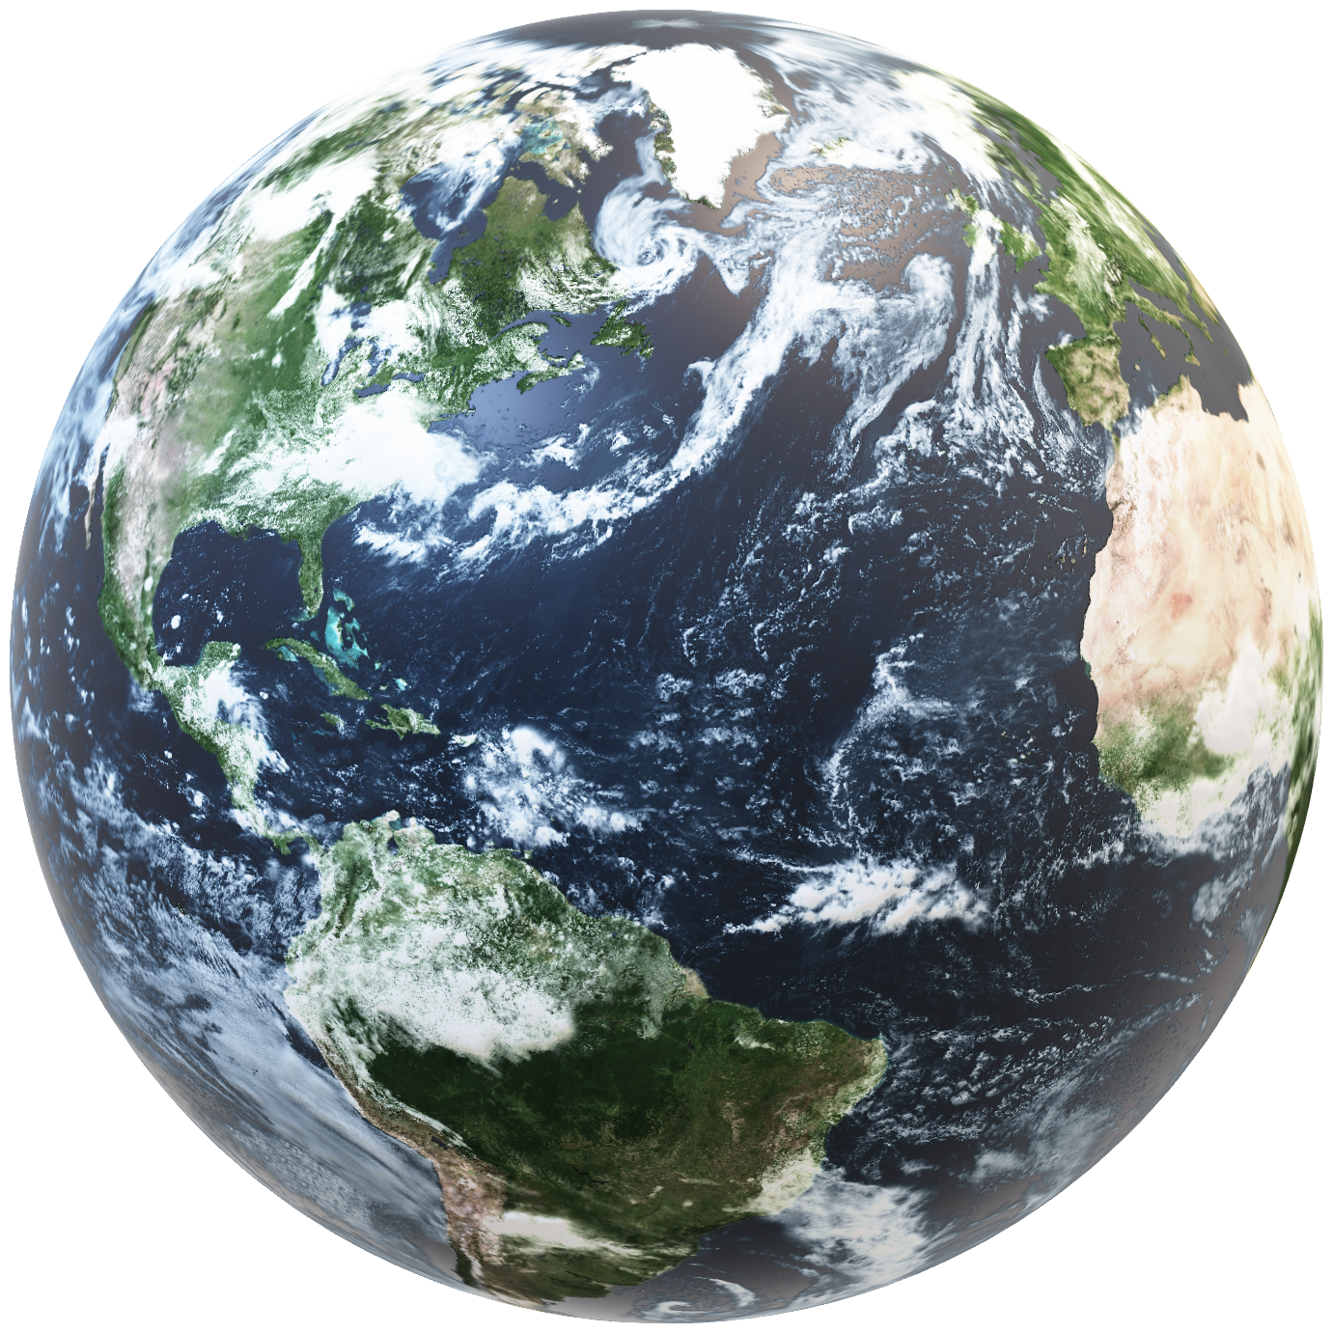
Future Developments
Personalized Heart-rate Thresholds
Temperature and Motion Data
Wearability/
Smart Device Integration
Clock Functionality
Add more indicators of sleep cycle
Hardware based, without the privacy concerns
Add smart watch compatibility
Sync to devices like alarm clocks, automatic blinds/lights to improve wake-up process
Use machine learning to customize your personal heart rate thresholds for each sleep phase
Improve-as-you-use
Customizable
Time zone automation

Slide 8

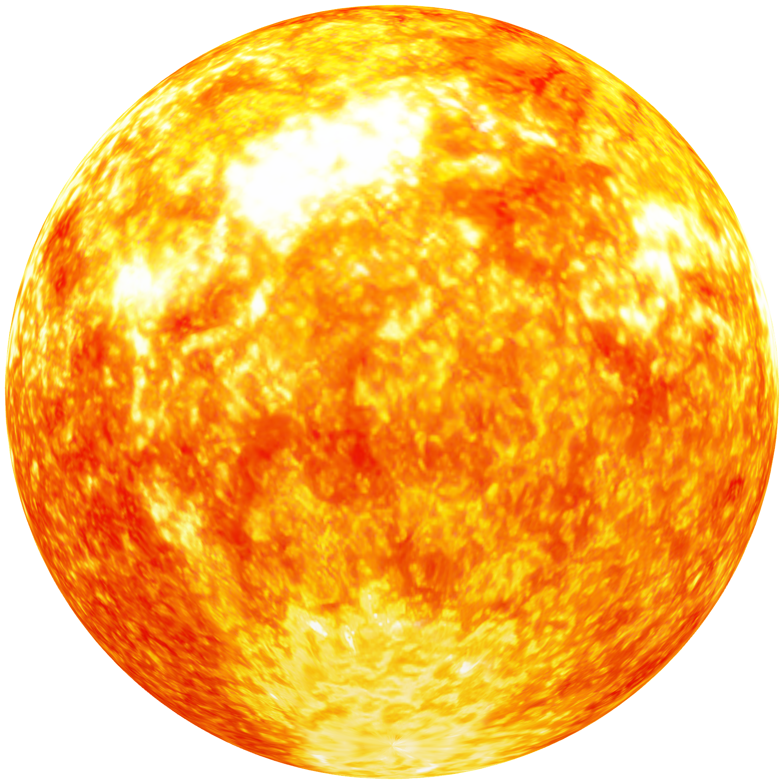

Business Viability
Sleep = $$$
Users:
Monetization:
Scalability:
Students
Working Adults
Parents
Initial purchase of device
Subscription based software with future developments
Expand to other apps
Different versions
Smart wearables market: $61 Billion

Slide 9
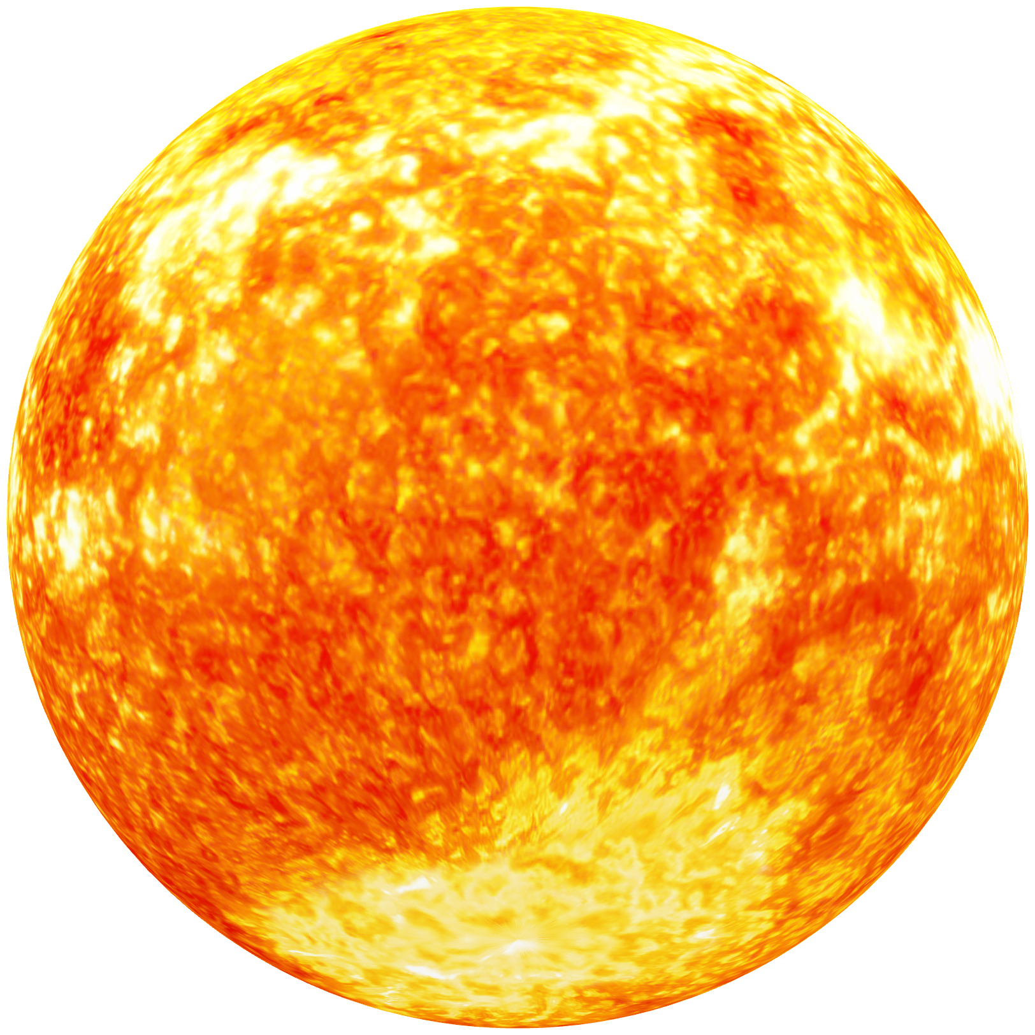

THANK YOU

